Slide 1
INDUSTRIAL ORIENTED MINIPROJECT SEMINAR ON LOW-COST SORTING NETWORK CIRCUITS USING UNARY PROCCESING
PRESENTED BY

Slide 2
ABSTRACT
Sorting networks differ from general comparison sort in that they are only capable of handling certain number of inputs.
In that their sequence of comparisons is set in advance.
The usual approach is to wire up a network of compare-and-swap(CAS)units in configuration called a batcher or bitonic.

Slide 3
ABSTRACT
In this project we are using Verilog HDL and Xilinx tool.
Sorting network is used to sort the data in sequence.
Unary processing makes the process simple.

Slide 4
ABSTRACT
In this comparison sorting we use unary processing.
unary processing compares two inputs and swaps according to the logic.
In unary processing, numbers are encoded uniformly in the sequence of 1’s followed by 0’s.

Slide 5
INTRODUCTION
To overcome the drawbacks of weighted binary radix and stochastic processing we use unary processing.
A sorting network is the combination of CAS blocks that sorts a set of input data.
Each CAS block compares two input values and swaps at the output.

Slide 6
INTRODUCTION
The essential operations in CAS blocks are minimum and maximum functions.
To synthesize the CAS block one AND and OR gate are required.
The maximum and minimum value functions are simple and low-cost unary implementations.

Slide 7
INTRODUCTION
Verilog HDL and Xilinx tool are used in this project.
Verilog code is similar to ‘C’.
It is easy to implement.

Slide 8
INTRODUCTION
Xilinx synthesis the code and provides RTL schematic.
Xilinx also provides the simulation output.
We use Xilinx 14.5 ISE version.

Slide 9
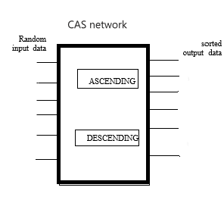
CAS NETWORK

Slide 10
CAS NETWORK
CAS represents compare and swap network
It consists of ascending and descending blocks
Here 8 input CAS algorithm builds the required network

Slide 11
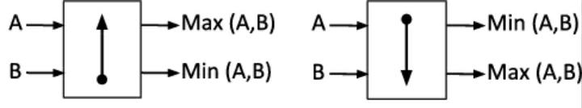
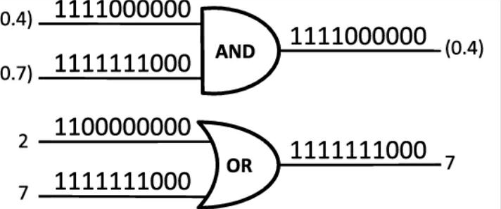
ASCENDING & DESCENDING CIRCUITS

Slide 12
ASCENDING AND DESCENDING
Ascending and descending represents maximum to minimum and minimum to maximum data respectively.
AND Gate gives minimum data as output.
OR Gate gives maximum data as output.

Slide 13
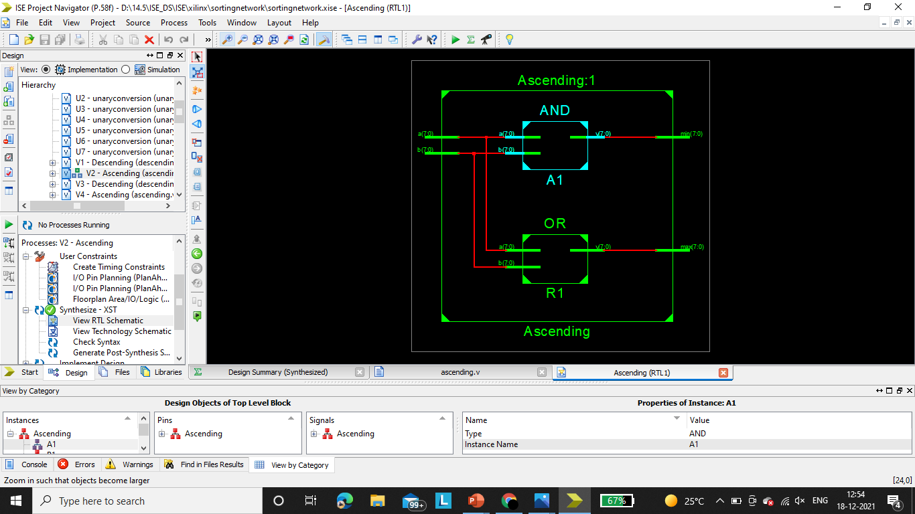
ASCENDING RTL

Slide 14
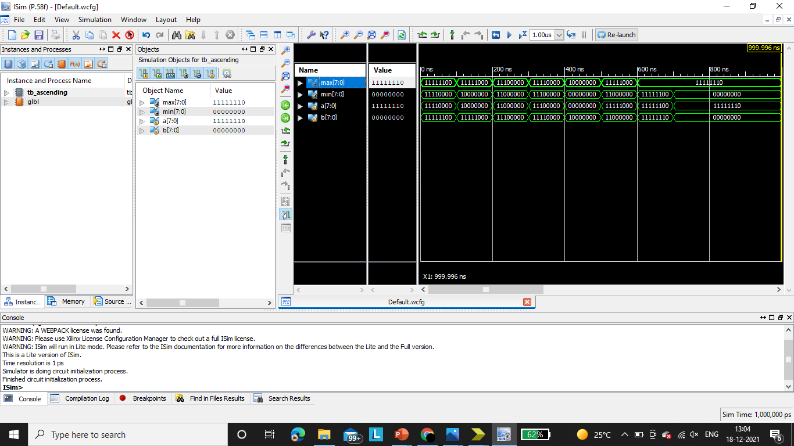
ASCENDING OUTPUT

Slide 15
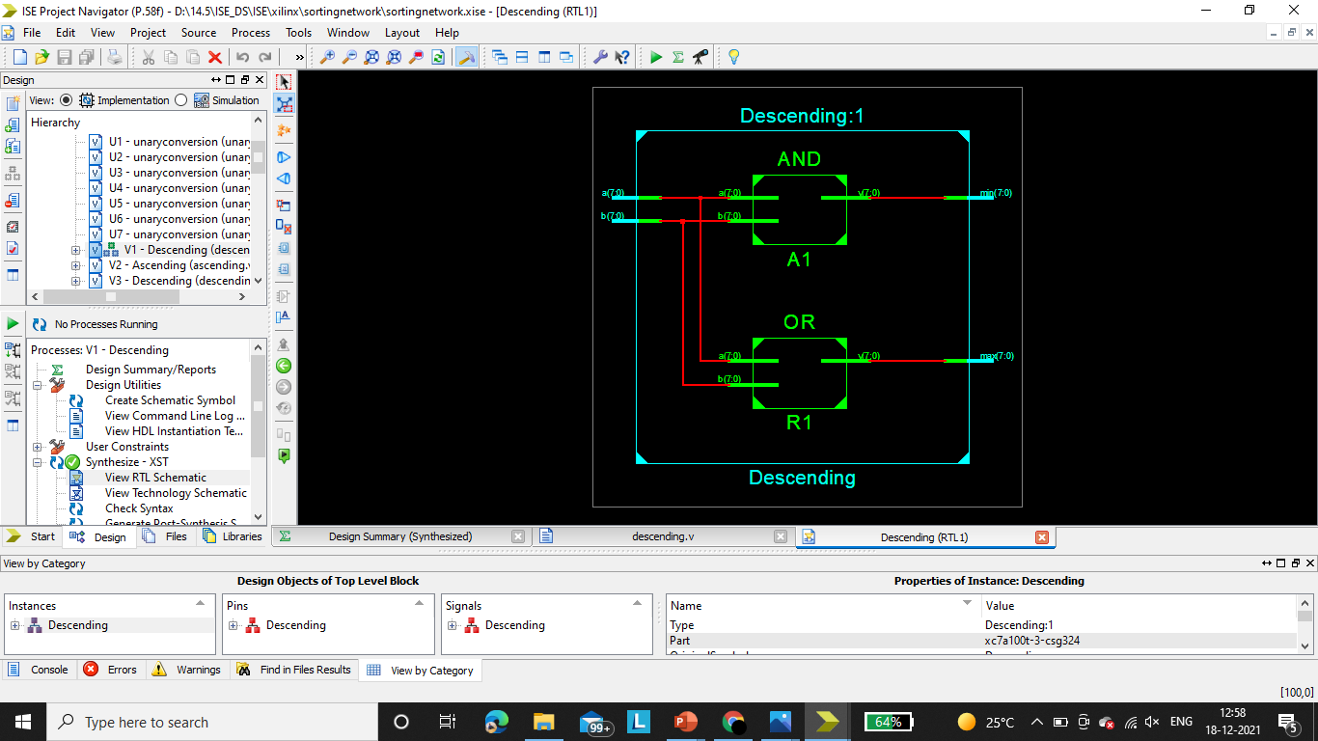
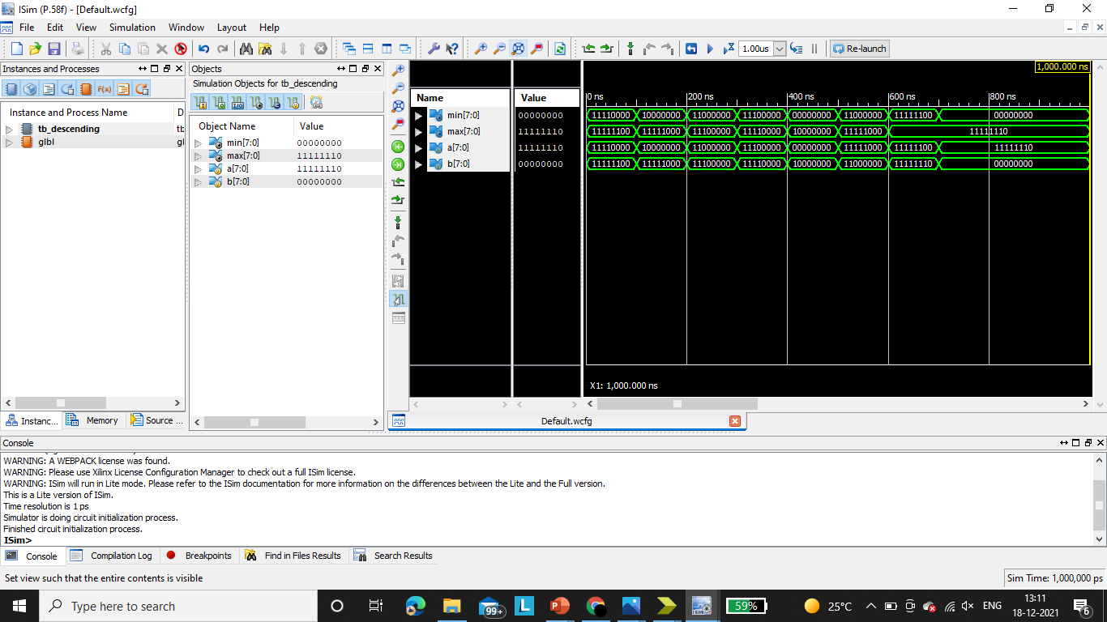
DESCENDING OUTPUT

Slide 16
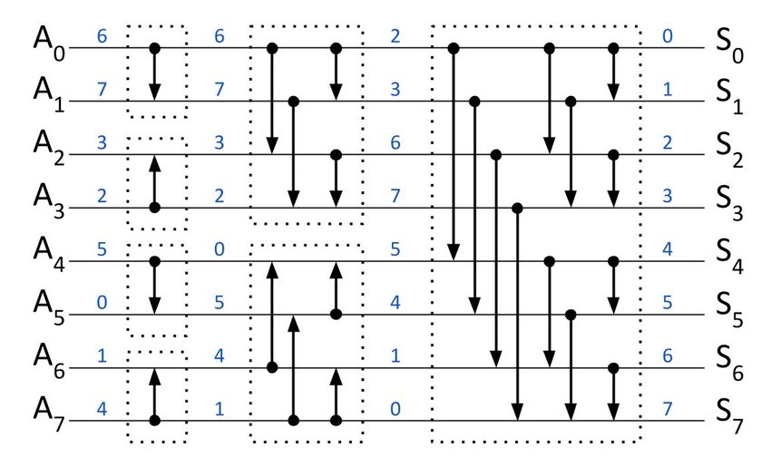
CAS NETWORK FOR 8-INPUT SORTING

Slide 17
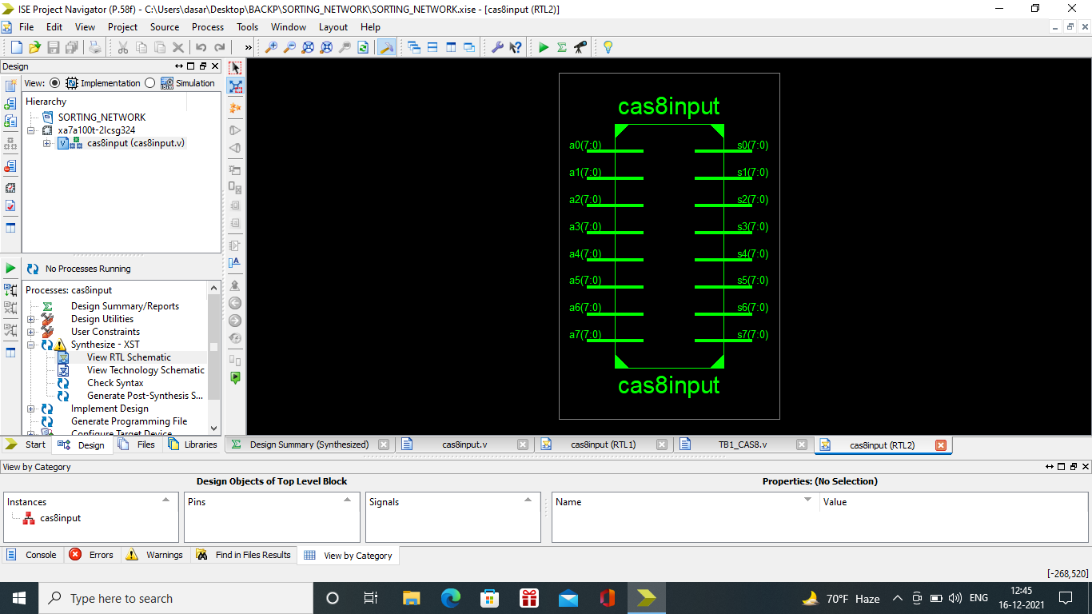
RTL SCHEMATIC : TOP MODULE

Slide 18
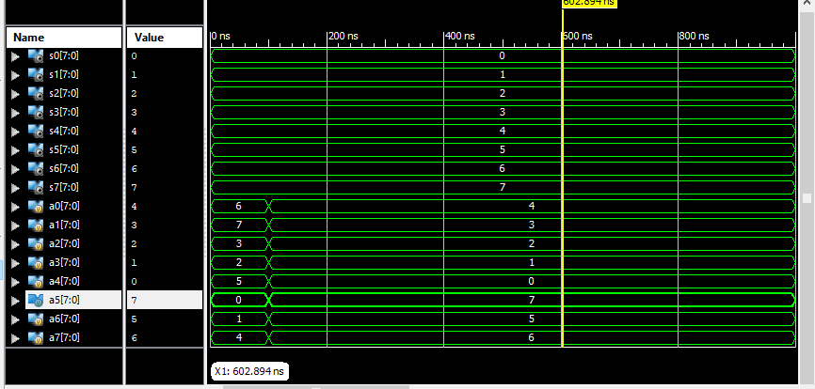
SIMULATION : TOP MODULE

Slide 19
Advantages
Low cost.
Easy to implement.
Requires less area.

Slide 20
Applications
signal processing.
Image processing.
Switching systems.

Slide 21
CONCLUSION
Sorting networks have been widely used in different applications.
Their regular structure makes them popular for signal processing systems and communication switching networks.
However, a conventional weighted binary-based implementation of a large sorting network is costly considering the large number of CAS units that such a network entails.
The VLSI cost increases significantly with increasing resolution of the input data.

Slide 22


